Slide 1
Interface for measurement tracking

Slide 2
Objectives
Facilitate tracking of measurement status for each studies
Avoid using multiple tracker for x-ray status and comments
Help to organize / delegate work

Slide 3
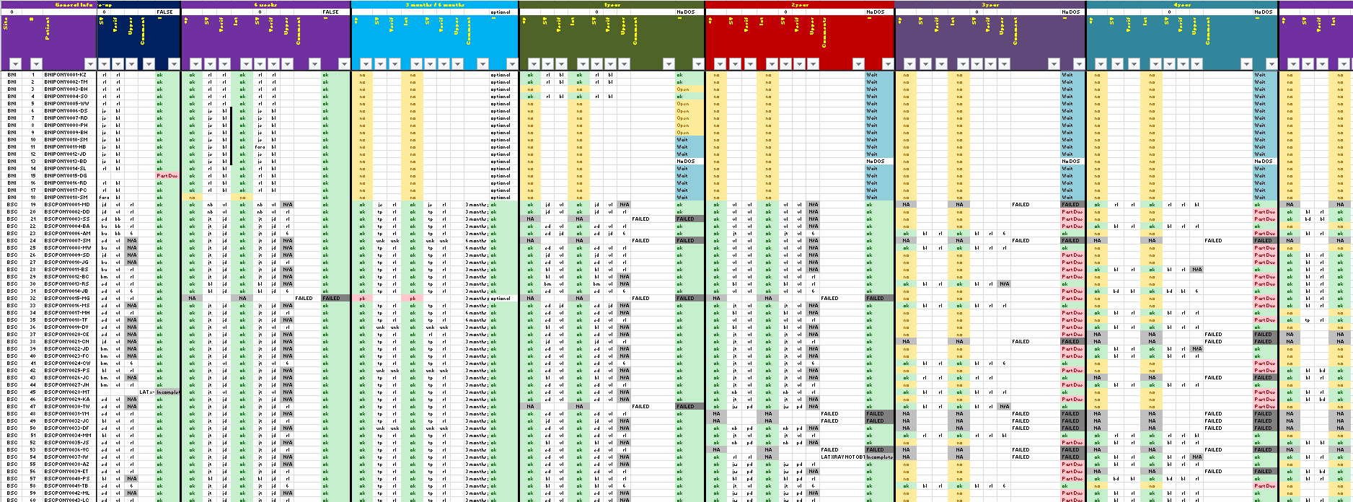
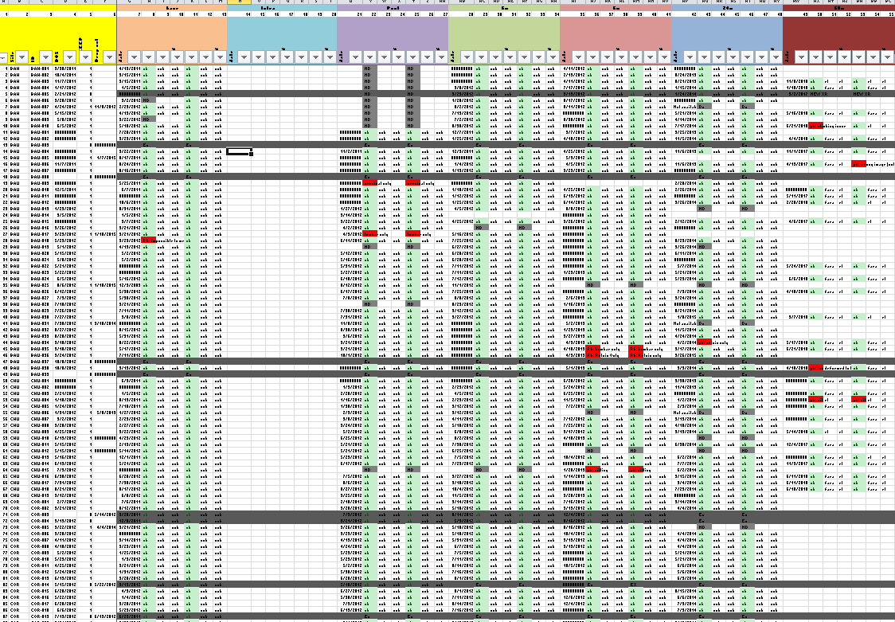
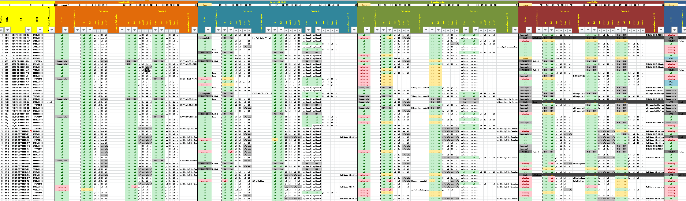
Current problem
Tracking x-ray measurement can be cumbersome:
Each tracker are “unique”
Different follow-up
Different type of x-ray
Need to know where are each study and the different priority
Measurement planning and measurement report require long time of preparation

Slide 4
Requirement for the tool
Interface for user
(Need to be able to identify yourself ?)
Tracker
measurement to do
verification to do
Depending on user, verification does not show-up
Image comments and quality
Image with problem need to be tracked (add comment)
Generate report
Number of measurement performed between a specific period
Image due / missing
Per study, per site, per branch, per patient etc …
Update
Add more studies
Close some study (if needed)
Should be able to handle in a close future automatic info from other tool
Update for online FTP
Automatic measurement from Surgimap
Etc …

Slide 5
Example of design (food for though)

Slide 6
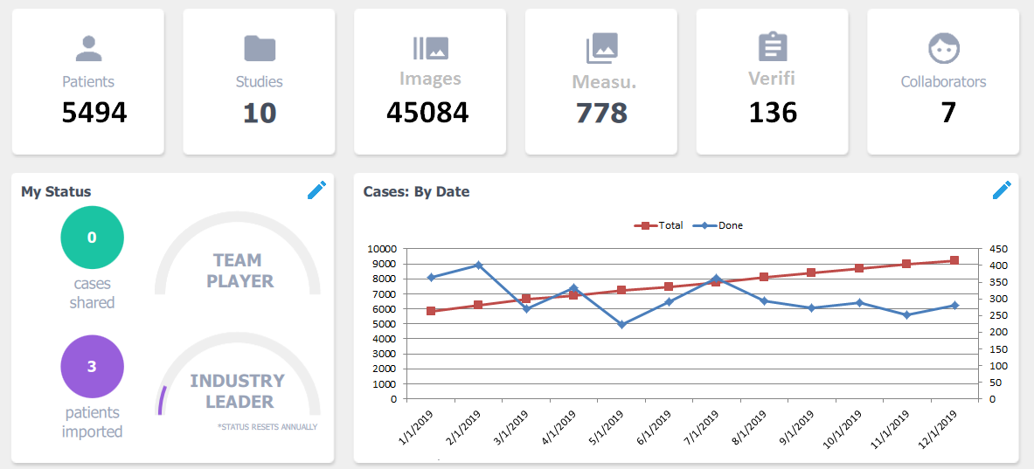
Overview

Slide 7
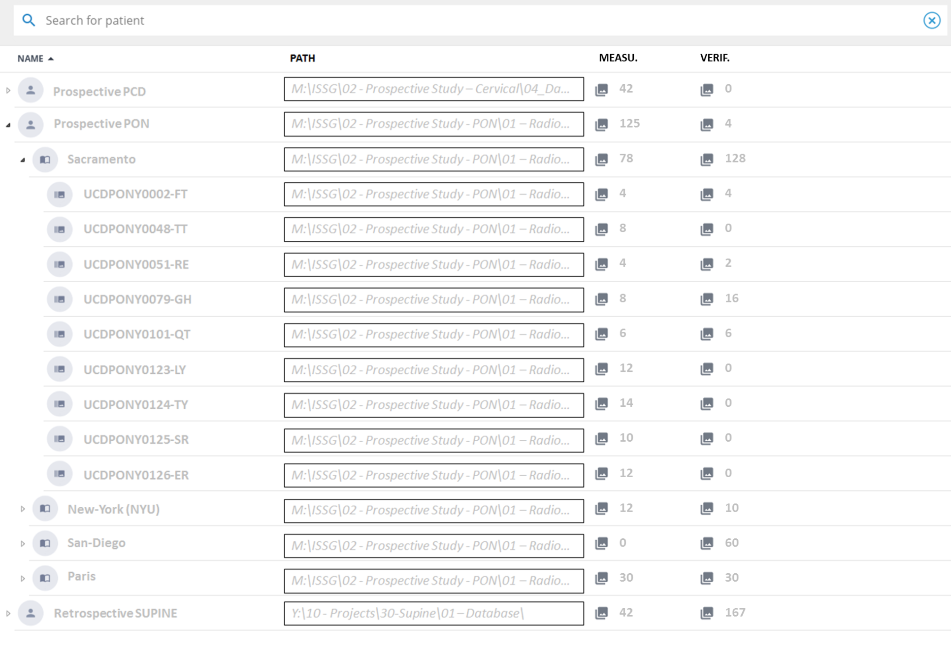
Detail view

Slide 8
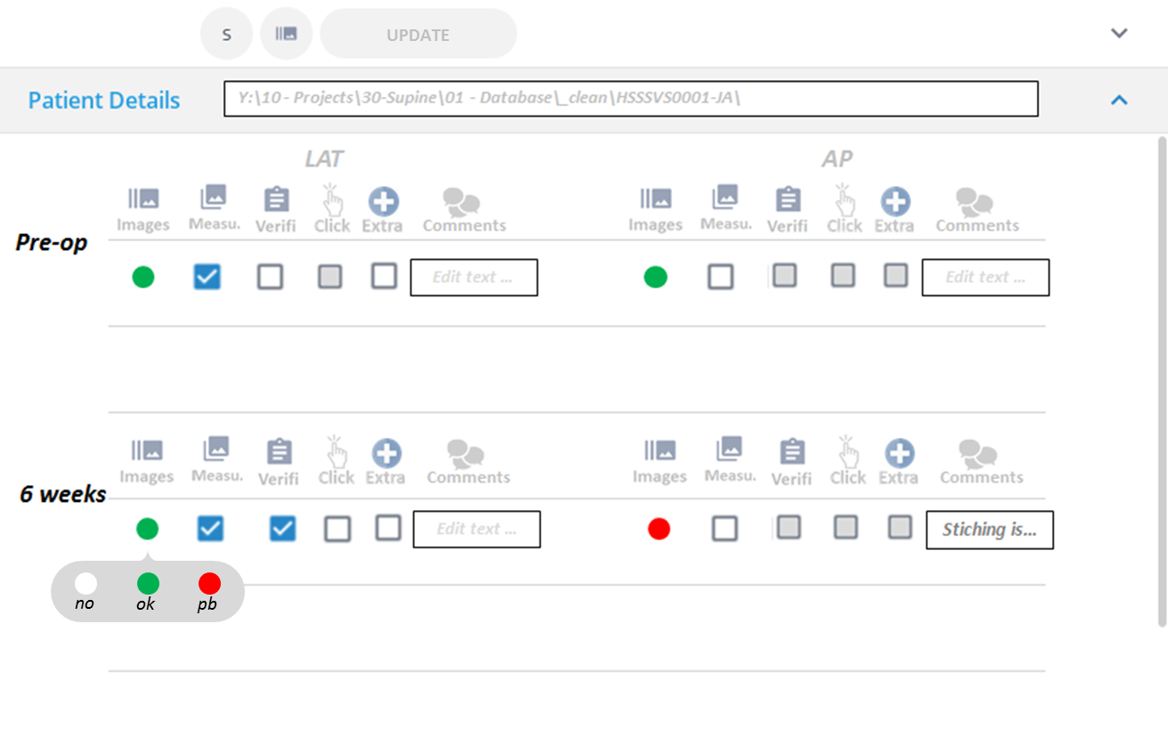
Detail by patient

Slide 9
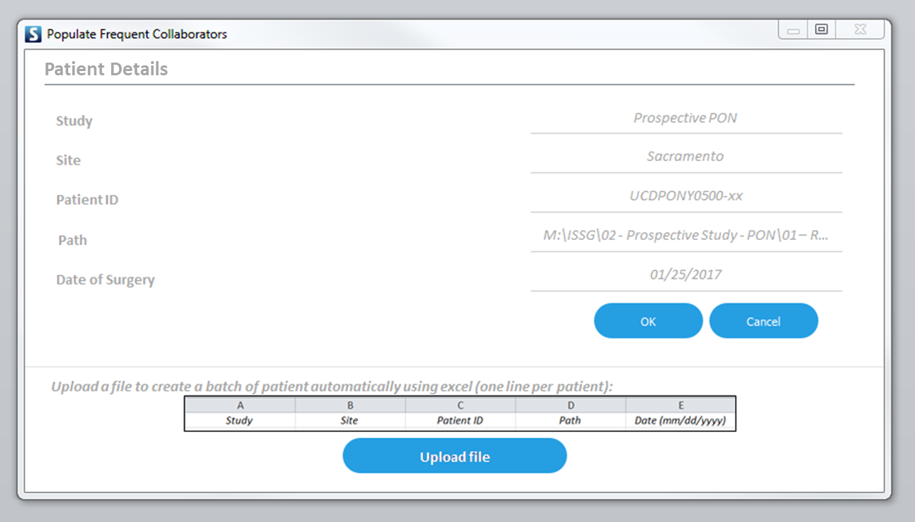
Create a new patient

Slide 10
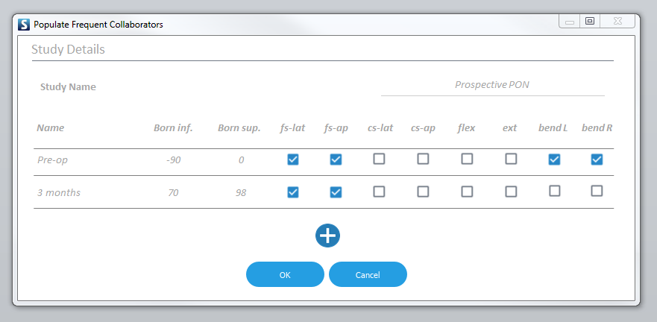
Create a new Study

